Slide 1

Bead Activities to teach Inference and Sampling Distributions
Kirstie Doehler (Associate Professor of Statistics)
&
Jim Beuerle (Associate Professor of Mathematics)

Slide 2
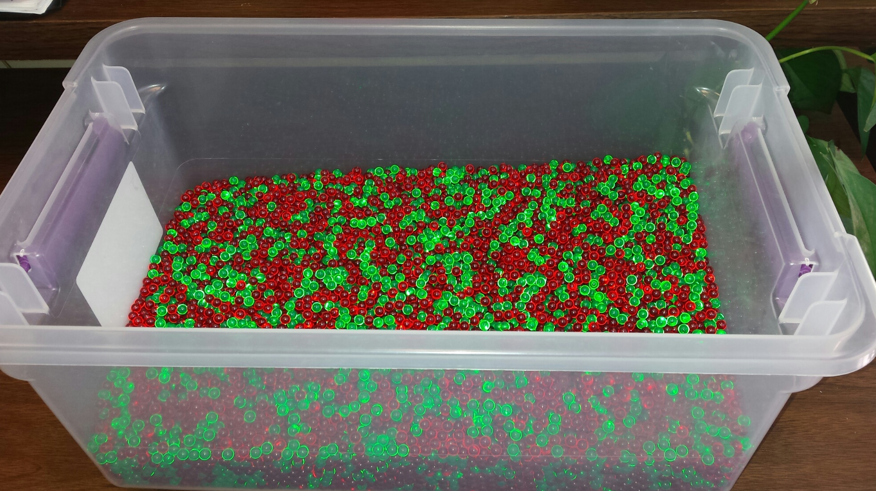
Beads?

Slide 3
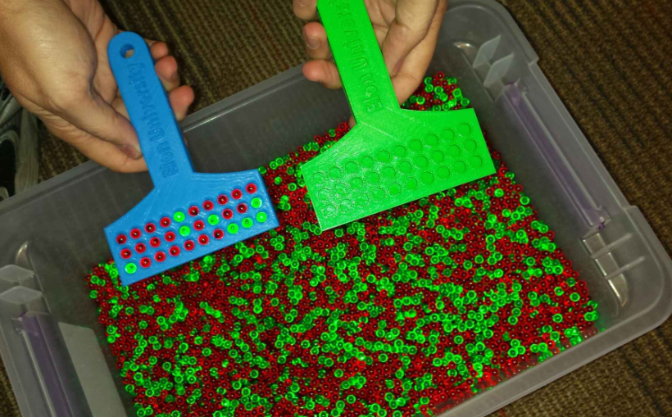
Beads?

Slide 4
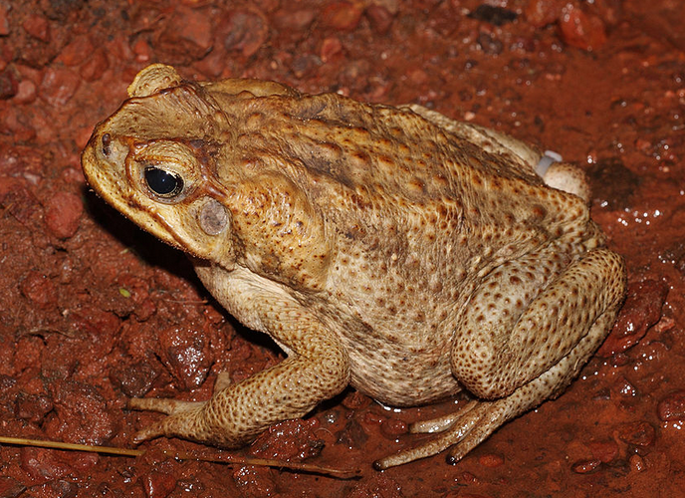
Sampling Distribution Activity
Activity: Dr. Doehler has a container with beads in it. The beads represent an invasive species of cane toads where the GREEN beads represent females and the RED beads represent males. A biologist is interested in estimating the proportion of the cane toad population that is female (GREEN beads). Due to time constraints, the biologist can only capture and measure 30 toads.

Slide 5
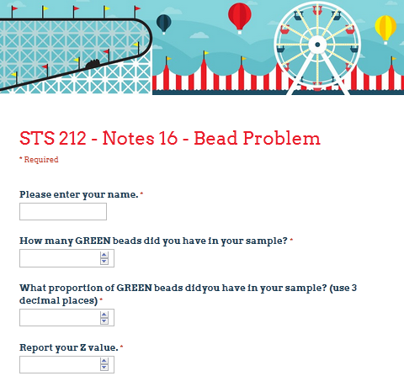
Sampling Distribution Activity Google Form

Slide 6
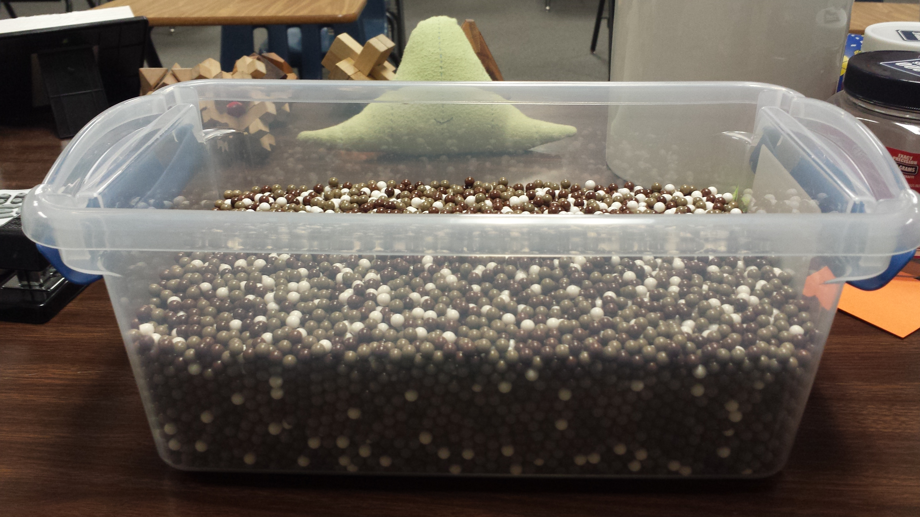
Sampling Distribution Activity Extensions & Additional Bins
Hypothesis Testing
Confidence Intervals
Central Limit Theorem (using different size scoops)
What would guess is the true proportion of darker beads?
“Brown” beads weigh 0.12 grams and the “White” beads weigh 0.20 grams

Slide 7
Where are the Beads & Bins?
We have:
4 bins full of beads, with more on the way
Several sets of scoops (samples of size 30 & 50)
Bead & bin supplies are located in Kirstie’s office (Duke 201A) and Jim’s office (Duke 209B).

Slide 8

Questions?

